Slide 1
RESTAURANT MANAGEMENT SYSTEM

Slide 2
INTRODUCTION
A Mini project on restaurant billing system using Java.
It has 3 classes and 1 interface:
GST(interface)
RestaurantApplication
Customer
RestaurantOwner

Slide 3
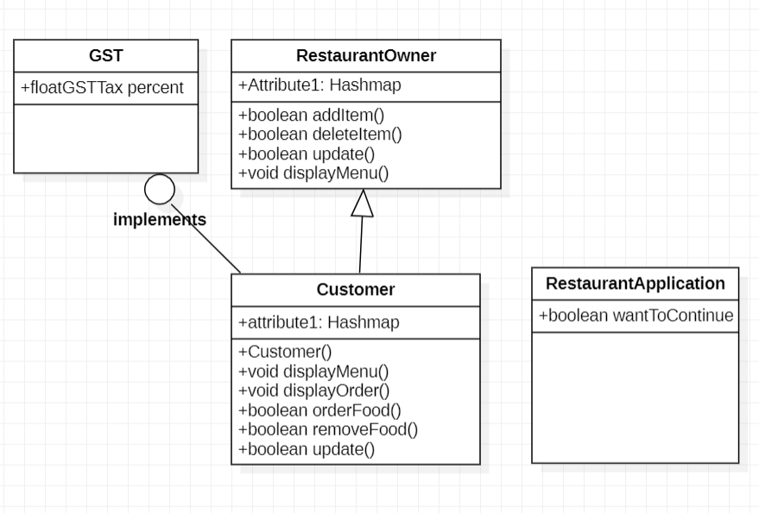
CLASS UML DIAGRAM

Slide 4
CONCEPTS USED IN CODE
HashMap: The HashMap class of the Java collections framework provides the functionality of the hash table data structure. It stores elements in key/value pairs. Package:java.util.HashMap.
Interface: An interface is a reference type in Java. It is similar to class. It is a collection of abstract methods. A class implements an interface, thereby inheriting the abstract methods of the interface. Along with abstract methods, an interface may also contain constants, default methods, static methods, and nested types.

Slide 5
.
SWITCH STATEMNET: The switch expression is evaluated once.The value of the expression is compared with the values of each case.If there is a match, the associated block of code is executed.
If STATEMENT: The Java if statement is the most simple decision-making statement. It is used to decide whether a certain statement or block of statements will be executed or not i.e if a certain condition is true then a block of statement is executed otherwise not

Slide 6
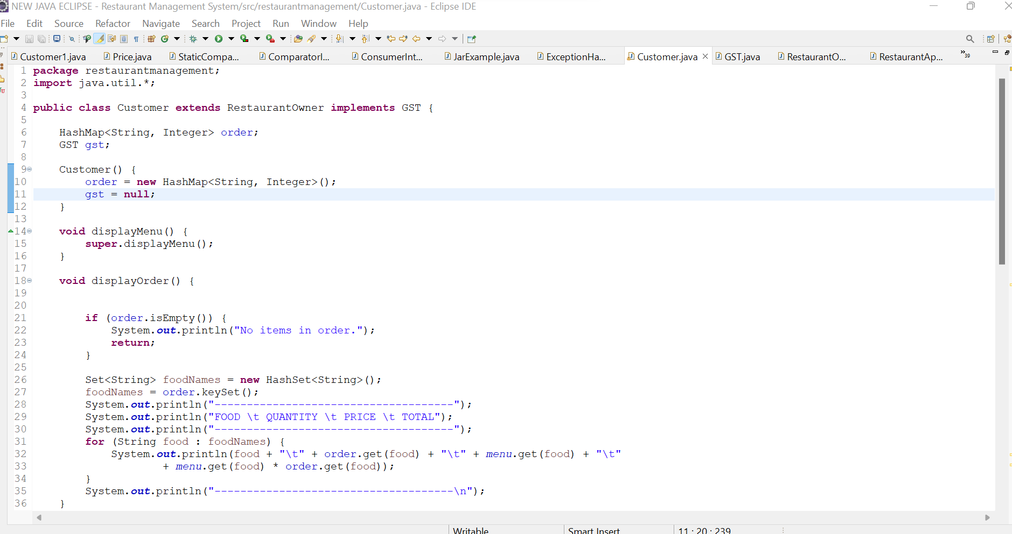
SOURCE CODE:

Slide 7
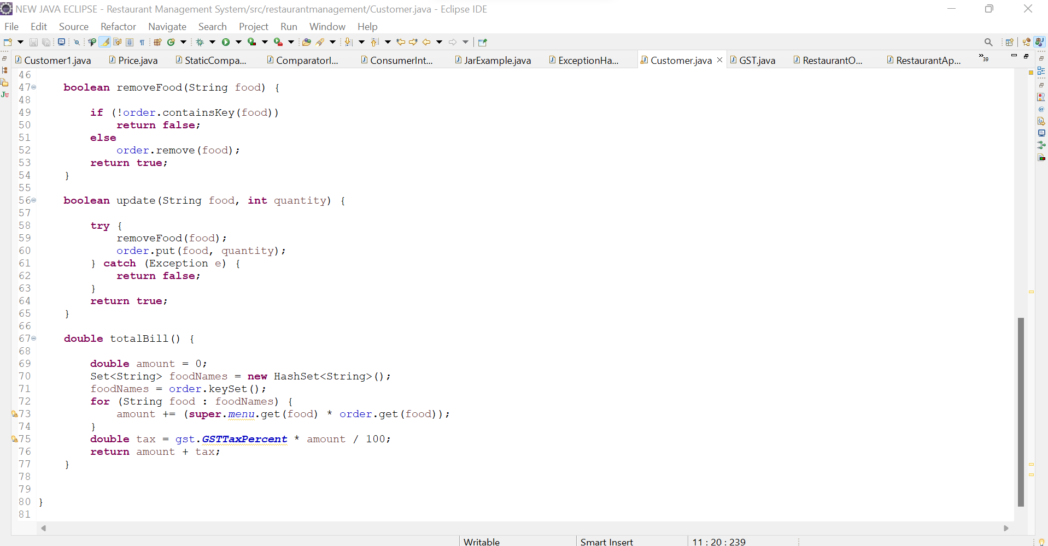

Slide 8
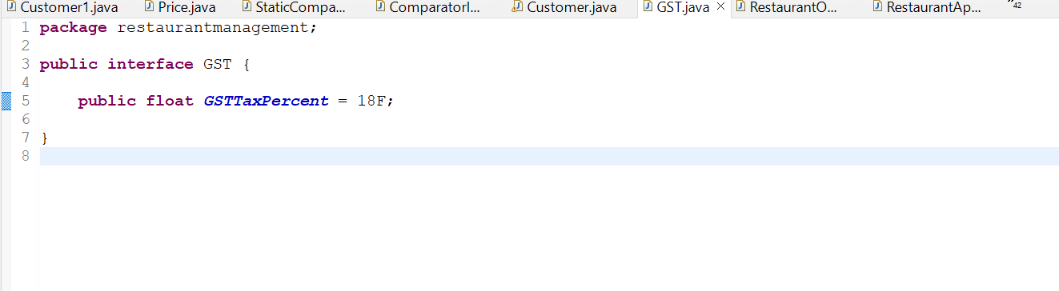
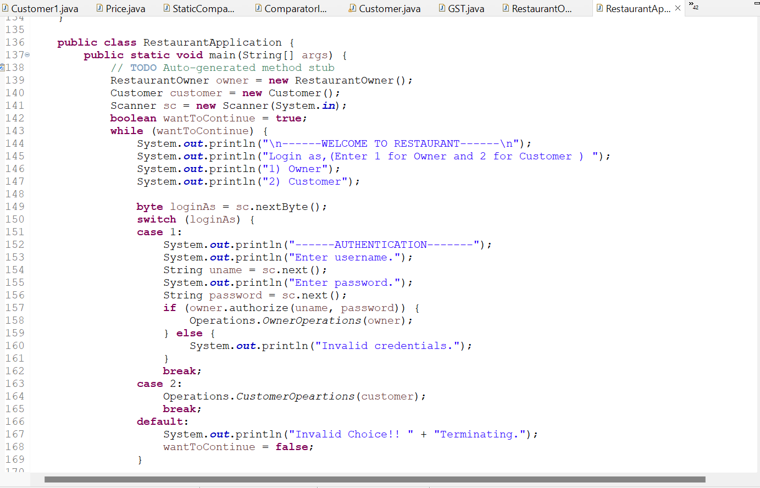

Slide 9
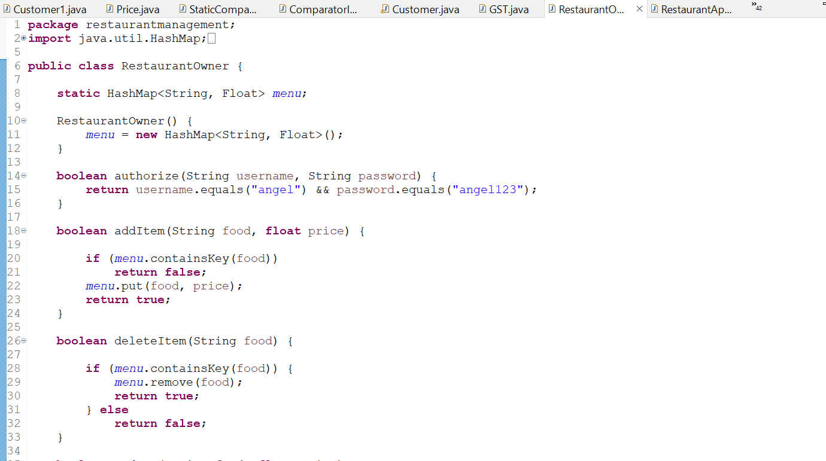

Slide 10
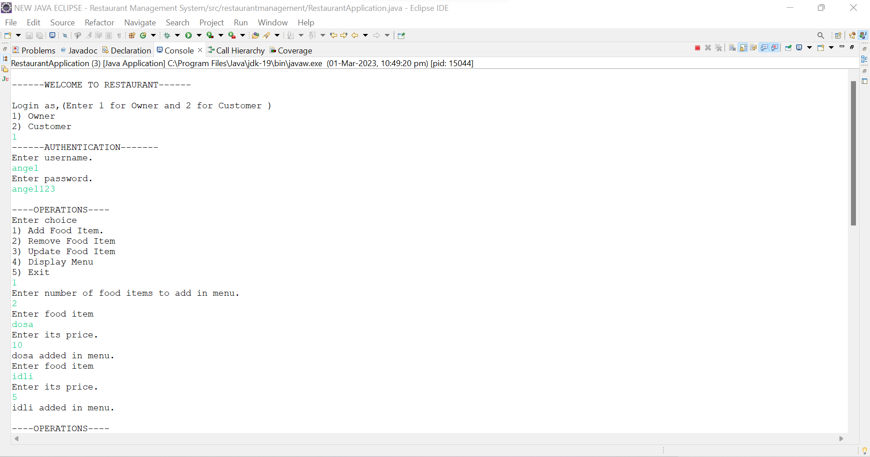
OUTPUT

Slide 11
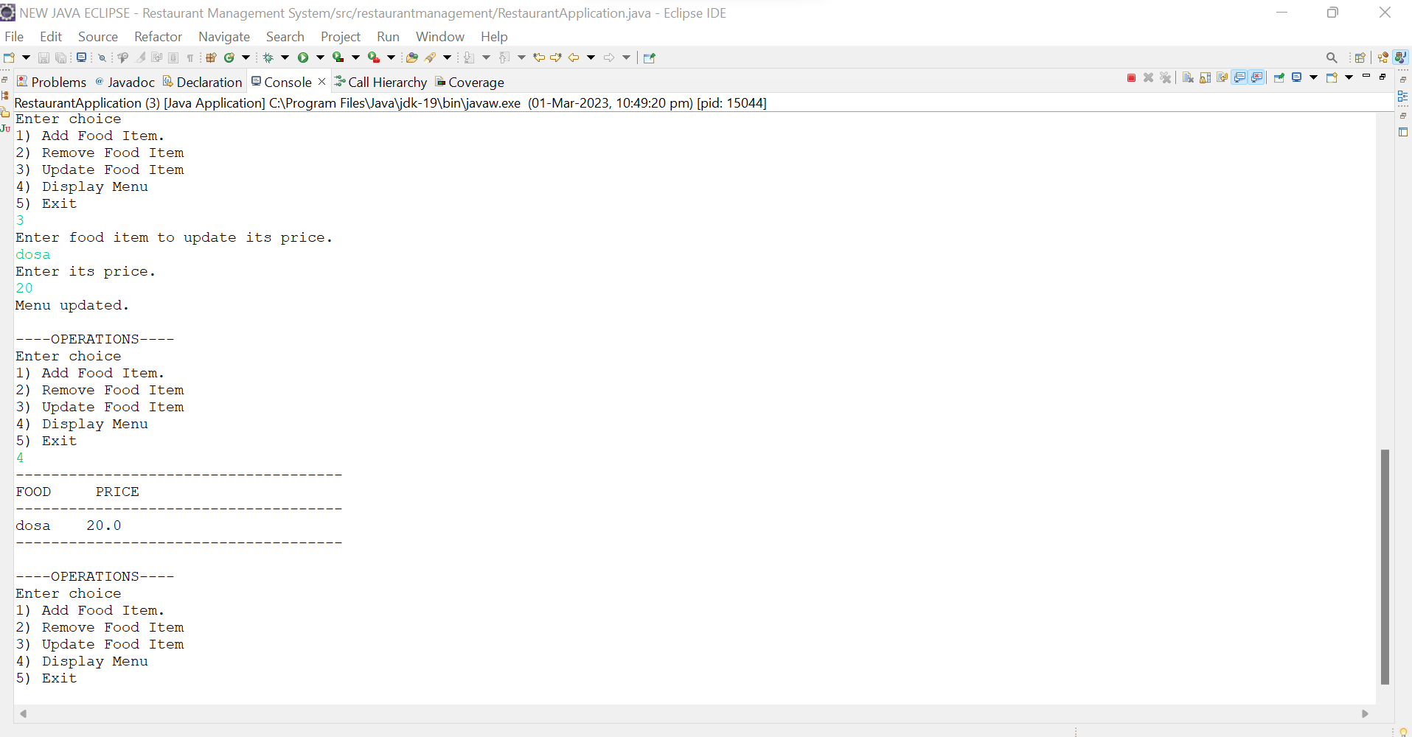

Slide 12
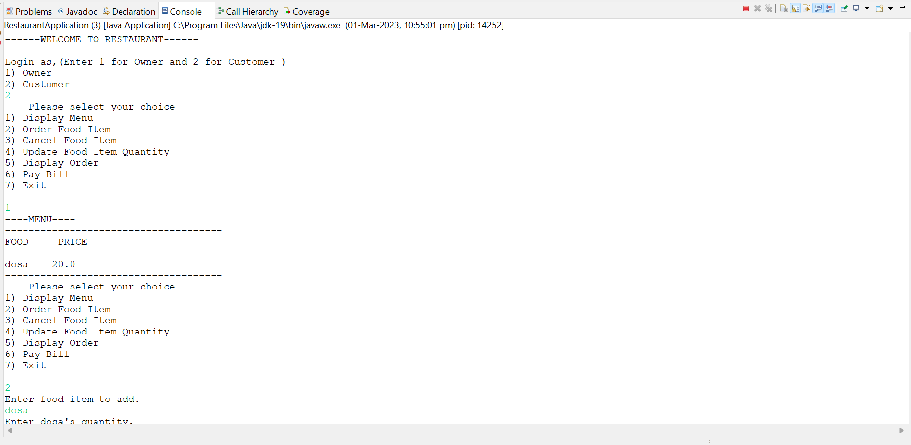

Slide 13
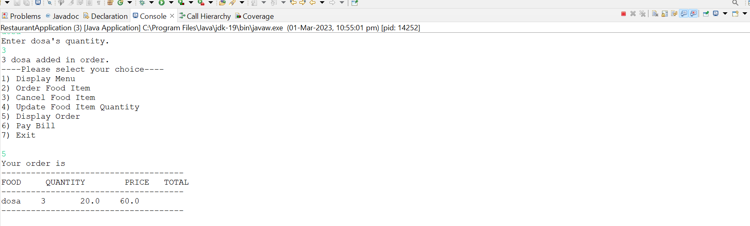
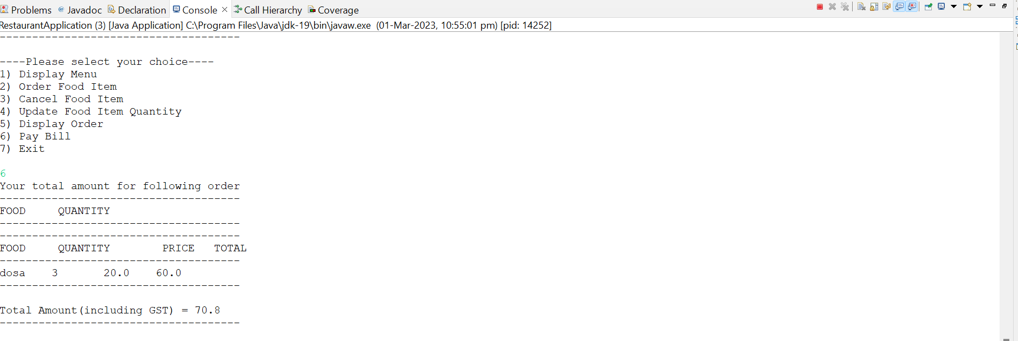

Slide 14
REFERENCES
https://javachain.com/java-hashmap-with-examples/
https://www.geeksforgeeks.org/hashset-remove-method-in-java/
https://www.geeksforgeeks.org/how-to-create-a-java-hashmap-of-user-defined-class-type/

Slide 15
CONCLUSION
In this project I have implemented “ Restaurant Management System”using java eclipse. This Application provides various options such as add,remove ,update and display and total bill. This Application give acess to both customers and restaurant owner.
In future , we can update this project by connecting eclipse to mysql.

